Slide 1
FLOWER RECOGNITION USING CNN
SUBMITTED TO:
PROF. VANDANA KATE
SUBMITTED BY:
SAHAJ MAKWANA: 0827CI191049
UTKARSH SHRIVASTAVA: 0827CI191061

Slide 2
PROBLEM STATEMENT
The proposed flower recognition system is implemented by developing a convolutional neural network which is a very efficient model for image classification. CNN models are trained by initially feeding a set of flower images along with their labels.
Flowers are the most attractive and distinguishing feature of a plant. Therefore flower recognition can help to know more about the plant. The two main common features of flowers are their color and shape. Those features can be used to train the model such that it can later identify an unknown flower.

Slide 3
ALGORITHM USED
CNN: CNN is a type of deep learning model for processing data that has a grid pattern, such as images classification, face recognition etc

Slide 4
LIBRARIES USED
OS used for directory
CV2 used for working of images
NUMPY used for working with arrys

Slide 5
APPROACH
First we import the necessary Python libraries to get started with the task of Flower Recognition with Python:
Then we Read each image in the data and create a label for each with the name of the folder:
Then convert the data into numerical values:
use the Label encoder and normalize the data:
split the dataset into 80% training and 20% test sets:
let’s build a neural network model for the task of Flower Recognition:
create more training images to prevent overfitting:
compile the neural network model:
let the model if it recognize flowers properly:

Slide 6
IMPLEMENTATION:
GITHUB:
https://github.com/utkarshri/ml-project
DATA SET
https://thecleverprogrammer.com/2020/11/24/flower-recognition-with-python/

Slide 7
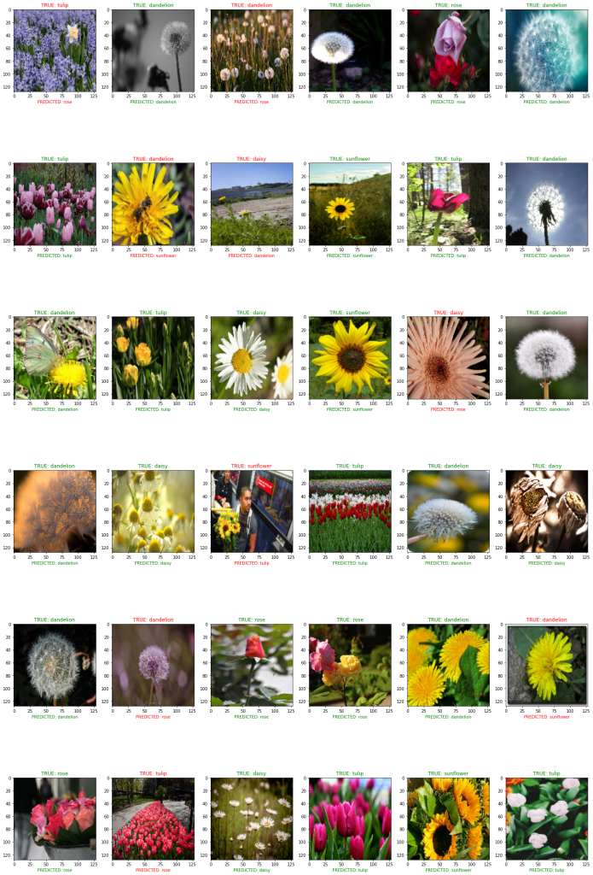

Slide 8
RESULT
While testing this model, we are getting a ~85% accuracy for the testing dataset

Slide 9
THANK YOU

